Slide 1
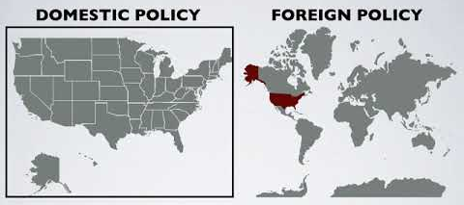
FOREIGN vs DOMESTIC POLICY
Domestic policy is what happens INSIDE a country.
EX: taxes; police; elections; health care; business

Slide 2
FOREIGN vs DOMESTIC POLICY
Foreign policy is what happens OUTSIDE a country’s borders. It’s kind of like a blueprint for how a country treats other nations.
EX: foreign aid; treaties; wars; trade

Slide 3

5 GOALS OF FOREIGN POLICY
Maintaining national security
Supporting democracy
Promoting world peace
Providing aid to people in need
Establishing open trade

Slide 4
BELL RINGER
CLASSWORK
Read p. 584-589
As you read, work on answering the given questions.
Lesson Close:
Think back to the 5 main goals of foreign policy. Pick one. What might be something that the United States could do to help meet this goal? Pretend that you are a reporter for a newspaper or TV station, and construct a brief news story reporting on the U.S. doing something to meet this goal. Be specific with details! (You may make them up.)

